Slide 1

Smart dustbin
Ayush patel
Aryan patel
Presented by
Ayush
Mentor
Prof. Usman Sindhi

Slide 2
What is the smart dustbin? (AIM)
Waste management is becoming complex and difficult day-by-day so for a short solution to this problem we have implemented the smart dustbin.
The project is based on sensor based circuitry which works automatically. It opens up automatically if some garbage comes nearby to the sensor.
Usually dustbins require human interaction, it is somewhat hectic for the user to check for the level of garbage frequently, so this helps a lot.

Slide 3
What will it do ?
The smart dustbin project consists of a sensor to detect human parts, the sensor will automatically generate a signal, and will open automatically press its lever
It opens automatically; when it receives the signal and locks after a few seconds own it's own

Slide 4
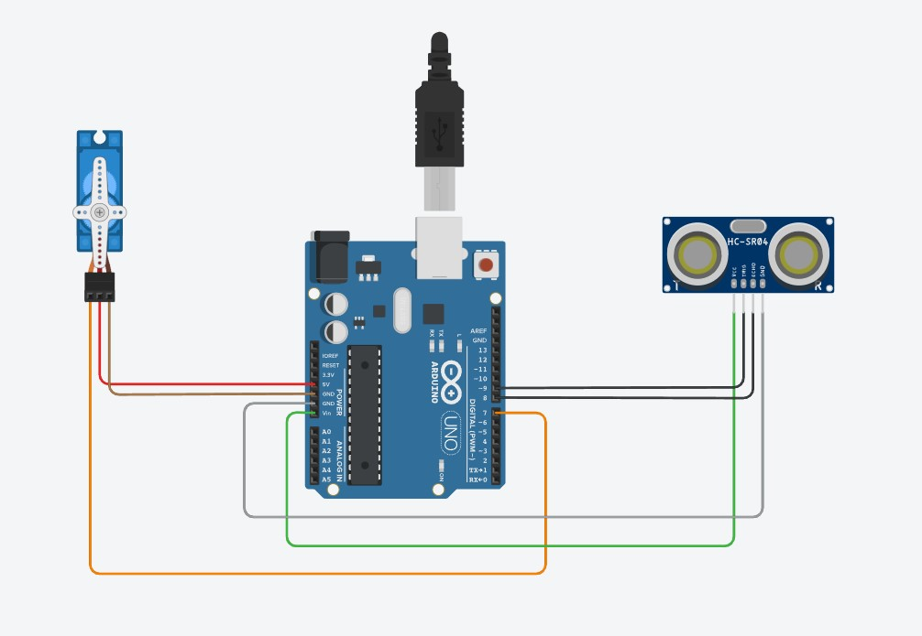
Components required
Circuit Diagram
Arduino Uno
Servo motor
Ultrasonic Sensor
Dustbin or Container
Jumper wires

Slide 5
How it works ?
Suppose if the ultrasonic sensor detects a hand or a leg of a human being or any other object placed nearby, then Arduino will measure the distances, if the distance is less than the predefined value then the Motor will be activated and Arduino servo motor will start and hence the head of the dustbin will be opened which is attached with the servo motor.
After a few seconds, it will close automatically.
Because the predefined value is given, it can easily be changed.

Slide 6
Thank you

